Slide 1

Sprint 4
Jelissa Reyes, Amy Inoa, Rahfat Chowdhury

Slide 2
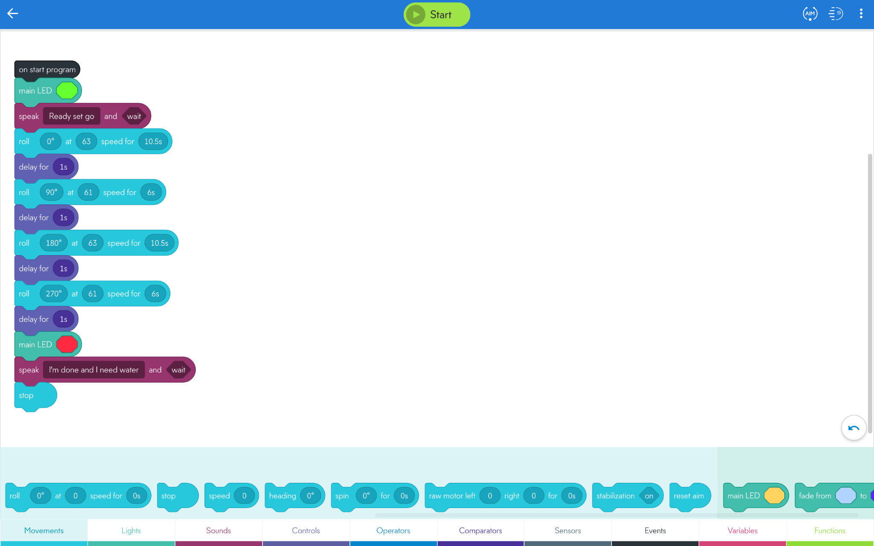
Sprint 1

Slide 3
Code Explained
Based on the directions provided, we set the robot’s color to green and programmed it to say, “Ready set go,” and wait.
After we calibrated the robot, we found that at 0° at 63 speed for 10.5 seconds was the perfect angle, speed, and time for the first move.
We delayed the robot for 1 second after each move to allow the robot to make a more accurate run.
For the next part, we set the robot at 90° at 61 speed for 6 seconds.
Since rectangles are parallel, we just used the same time and speed for the opposite sides. We just changed the degrees.
It rolled at 180° at 63 speed for 10.5 seconds. Then it rolled at 270°at 61 speed for 6 seconds.
Again, based on the directions provided, we changed the robot’s color to red and programmed it to say, “I’m done and I need water,” then waited and stopped.

Slide 4

Video

Slide 5
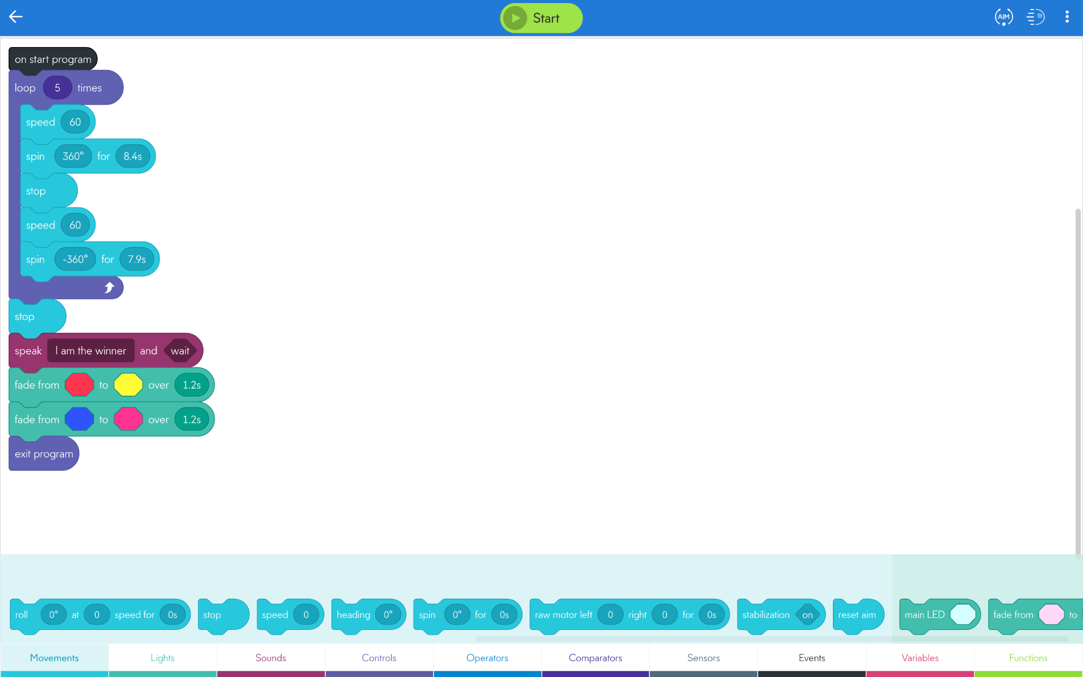
Sprint 2

Slide 6
Code Explained
Sprint 2 required us to code the robot to run the figure eight course 5 times
As required in the sprint 2 requirements, we first set up the robot to loop 5 times.
We then set the robots speed to 60 to stay consistent with the angle we would have robot go in
We then set the robot to spin in a 360 degree angle for 8.4 seconds to complete the first circle of the figure eight.
We then had the robot stop and then set the speed to 60 to have the robot go at a -360 degree angle for 7.9 seconds to complete the second half of the figure eight circle
Once the robot completed looping the figure eight 5 times we had the robot stop
Once it stopped we had the robot Speak “I am the winner” and had it Wait
After it waited we had the colors in the robot fade from red to yellow for 1.2 seconds
After it completed the first color fade we then had the robot complete a second color fade which was from blue to pink for 1.2 seconds
We then exited the program due to the robot completing the full course and all the requirements of Sprint 2.

Slide 7
Video

Slide 8
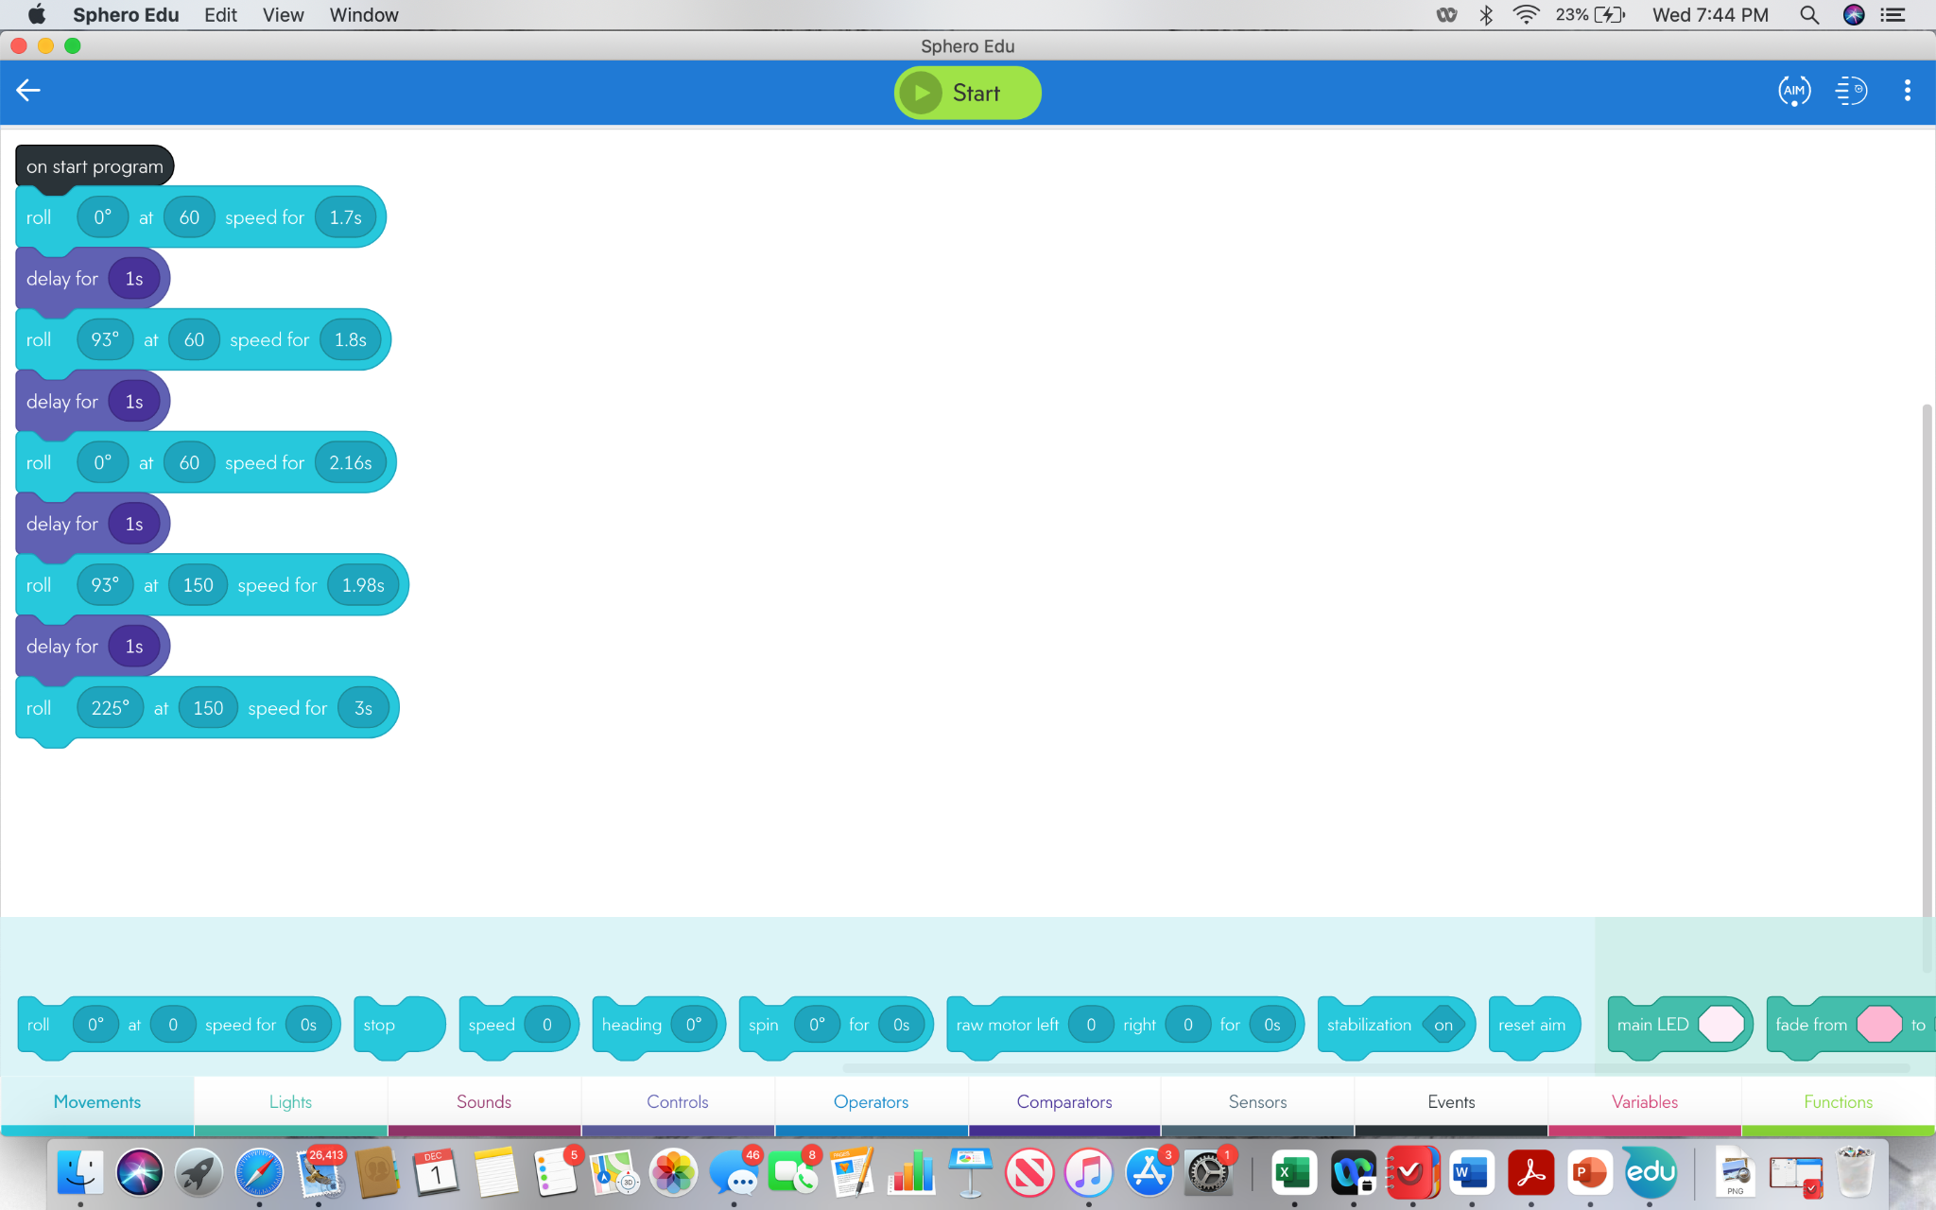
Sprint 3

Slide 9
Code Explained
-We chose to set the speed at 60 because it allowed the robot to go a moderate speed throughout the course until needed
- We also chose to delay the robot after each direction and code so that the robot could be more accurate when moving in the angles
-We found that the angles were not perfect degrees, which is why we chose to use 93 degrees for some of the coding
-We chose to increase the speed so that the robot would have the ability to go over the binder and hit the pins successfully, if at a slower speed, this would not happen
-For each turn and speed that we did, we made sure to adjust each time perfectly so that it would end at endpoint of the lines
-We also made sure to calibrate the robot precisely to avoid the robot hitting any of the objects

Slide 10
Video

Slide 11
Roles of each Team Member
Each Team member worked together so that we could get the project done easier
Each team member worked together outside of class at the same time with the robot to get the code and for it to run and to take the videos
Each team member took on multiple tasks and worked together to put each System Design Document Together
For example, algorithm, flow chart, requirements table, staffing plan, gantt chart, code
algorithm-Rahfat, flow chart-Jelissa, requirements table- Amy, Staffing plan- Jelissa, gantt chart- all group members, code-all group members
One member would take the video
Each member would upload all of their tasks to the github, which helped us successfully collaborate together

Slide 12
What we have learned and what we do differently
We successfully learned how to block code
We also learned a lot about how both direction, speed, and angles all play big roles in accuracy
We would most definitely change our views from when we first started and how we did not know how to calibrate the robot
We also would change the fact that we can change the speed to get it more accurate rather than the direction
We would also learn to record all of our trials for the next time

